Slide 1
Introduction to Deep Learning in Computer Vision
Convolutional Neural Networks, Transfer Learning
Notes:
Self-introduction

Slide 2
Aims and Scope of Workshop
Participants should ideally have:
Basic Python programming knowledge
Basic knowledge of Machine Learning
Basic idea of Neural Networks
Goals for this Workshop is for participants to:
Understand the types of problems that Computer Vision tackles
Understand the basic theory of Convolutional Neural Networks (CNN)
Implement an image classifier with Transfer Learning
Notes:
So many things to share about deep learning and computer vision. Focus today will be to teach 1) gain a basic understanding for com vis and CNN (commonly used model for image classification) 2) tackle com vis task with transfer learning - efficient as pre-trained models have already been trained on large amounts of data, and by using this we can have models with high accuracy even with only a basic understanding of CNN.

Slide 3
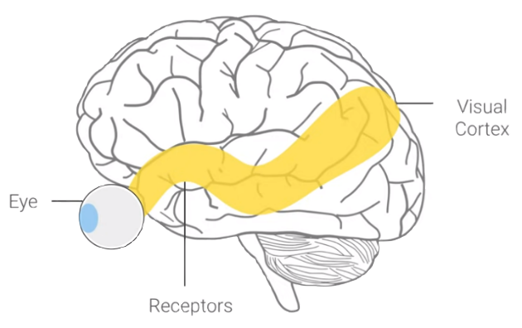
What is Computer Vision?
Similar to how human beings process images, Computer Vision is a field that enables computers and systems to derive meaningful information from digital images, videos, and other visual inputs.
Notes:
Simulate how humans process images with machines. Eyes - Capturing, Receptors - Accessing, Visual cortex - processing. Humans have had millions of years of evolution to “train” our eyes/receptors/visual cortex, so we have that advantage over machines. Trying to recreate it with machine learning.

Slide 4
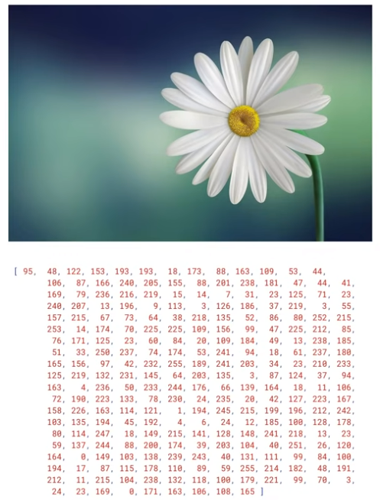
What is Computer Vision?
Computers don’t process information like humans do. It is difficult for them to understand an image without context.
However, using Machine Learning, we can teach computers to derive context based on repetition.
Notes:
Images are processed diff. Computers just see numbers (pixel information). Without context, machines cannot understand. Like in programming, you need compilers/interpreters, machines need a way to interpret pixel info as image. Which we can teach during iterations - training the machine again and again, for example, what numbers would you see for a sharp boundary vs blurred boundary.

Slide 5
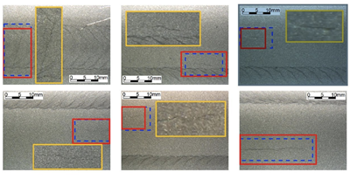
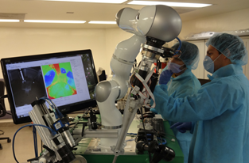
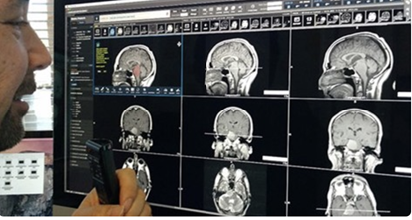
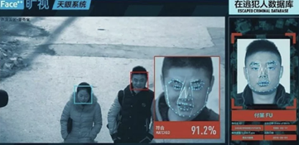
Application of Computer Vision
Defect detection
Robotics-assisted surgery
Detecting brain bleeds
Face recognition

Slide 6
Computer Vision Tasks
Notes:
The specific neural network that accomplishes these tasks

Slide 7
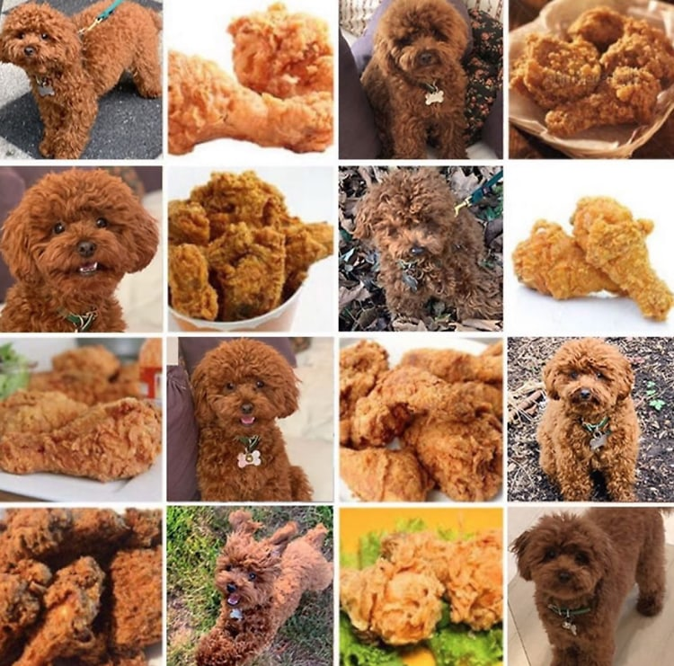
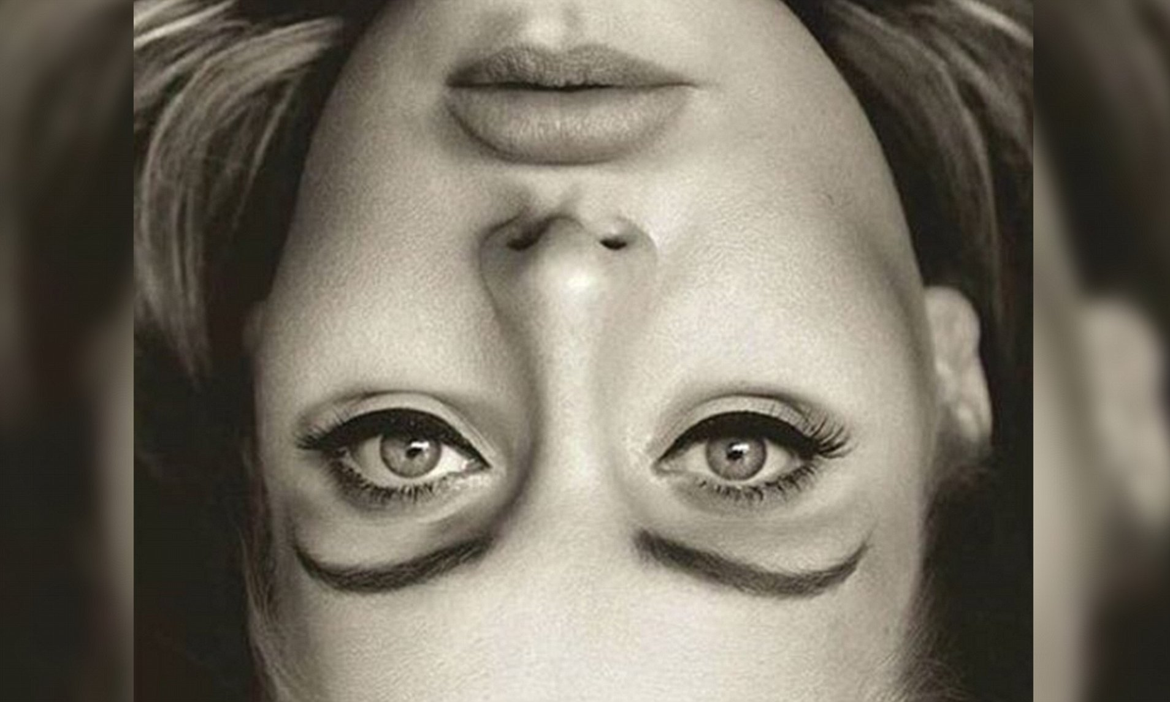
Object Classification
Some images may even be challenging for people to differentiate.
With sufficient data, ML models will be able to differentiate these images. Some even with up to 99% confidence.
Notes:
General tasks undertaken by CV

Slide 8
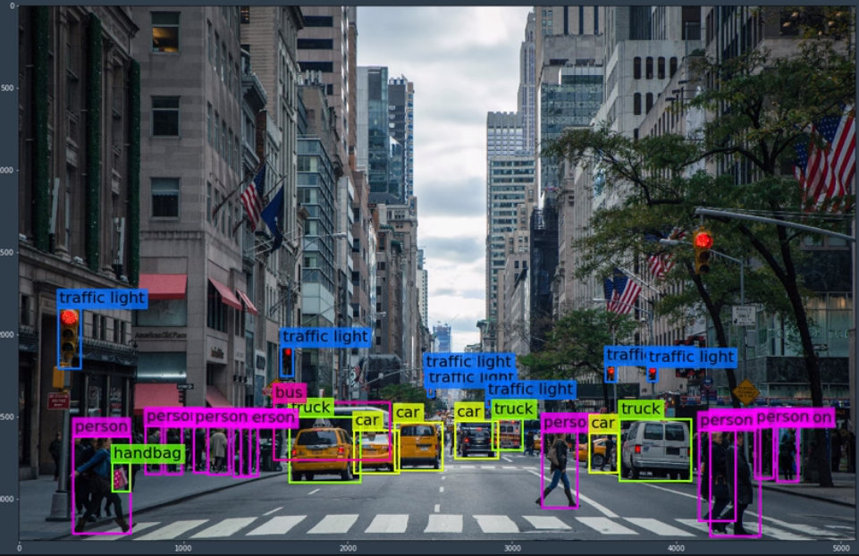

Object Detection & Segmentation
Object detection generally refers to the localization of objects within an image with multiple objects.
These objects are wrapped in bounding boxes.

Slide 9
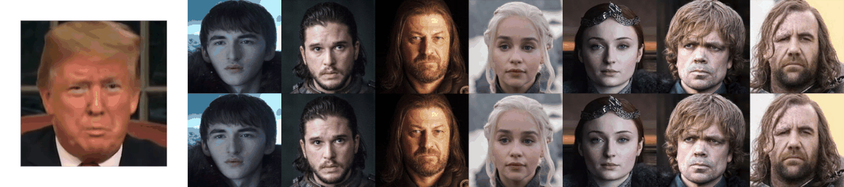

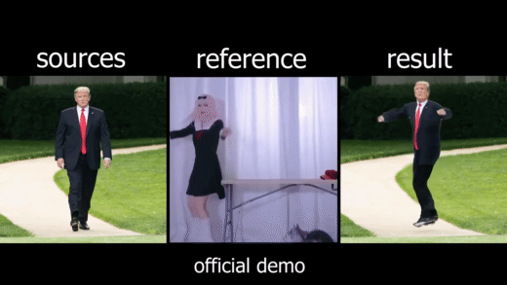
Other Computer Vision Tasks
Tracking
Image/Video Generation

Slide 10
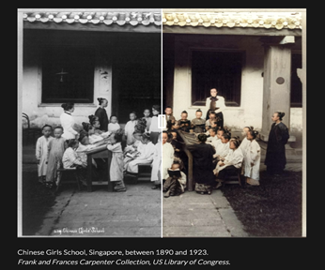
Other Computer Vision Tasks
Let’s try a comparison for colourization!
Convert image to grayscale:
https://colab.research.google.com/drive/1fX_MLqfOoKtPqkCl1KOL886ghLv6X8a8?usp=sharing
Colourize with DL:
https://www.myheritage.com/incolor

